Slide 1
Attentional Discounting in Gains, Attentional Amplification in Losses
Brenden Eum
Stephen Gonzalez
Antonio Rangel

Slide 2
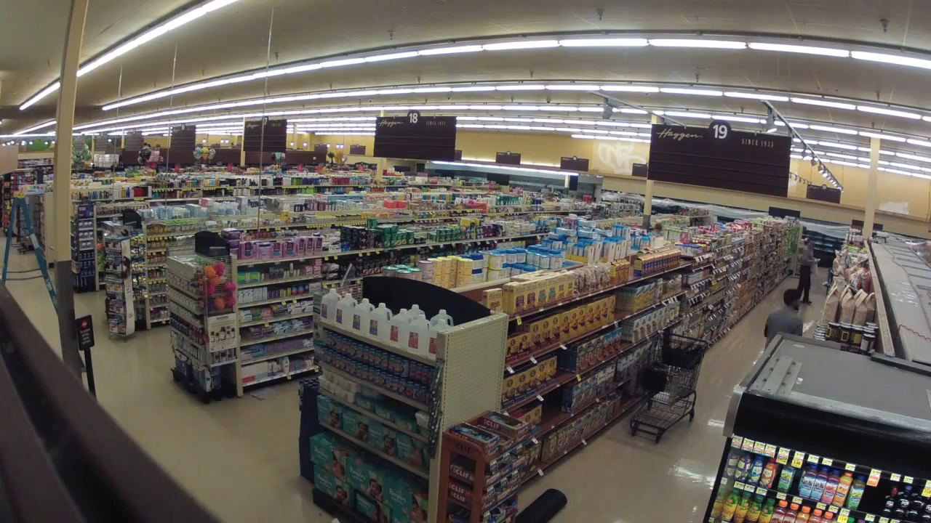




Slide 3
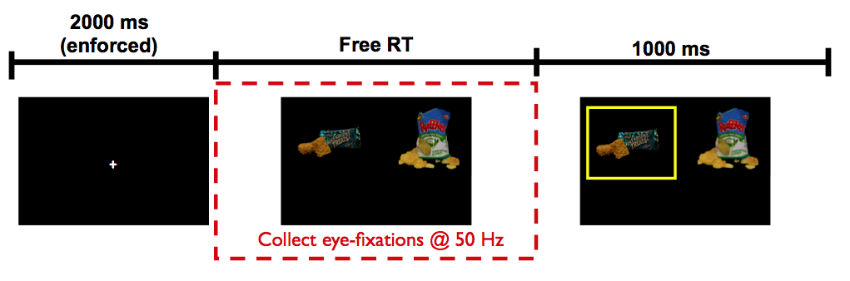

Krajbich, Armel, Rangel (2010, Nat Neuro)

Slide 4
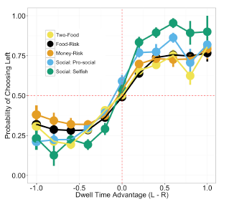
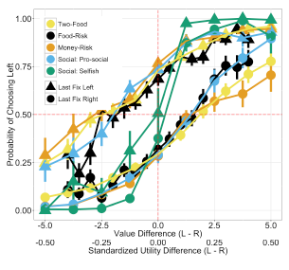
Net Fixation Bias
Last Fixation Bias
Smith, Krajbich (2018, J Exp Psychol Gen)
Notes:
multiple domains

Slide 5
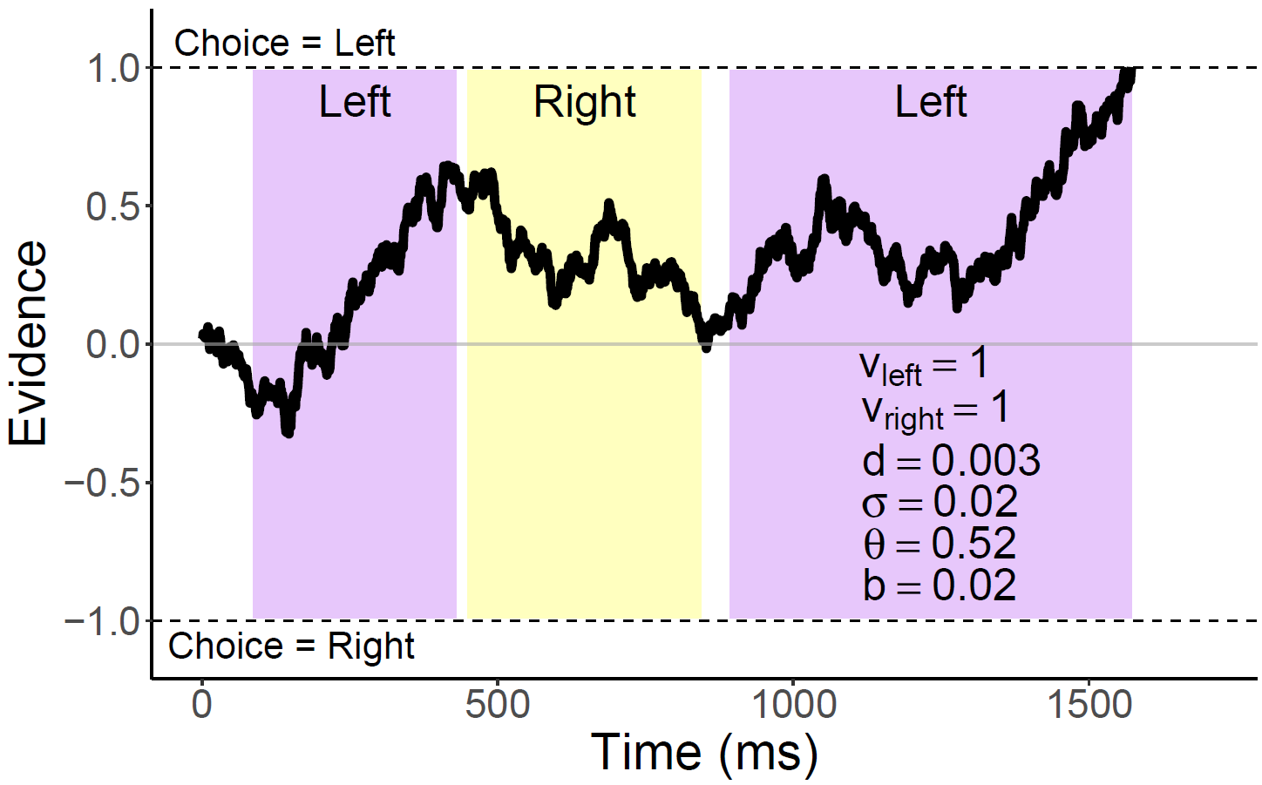
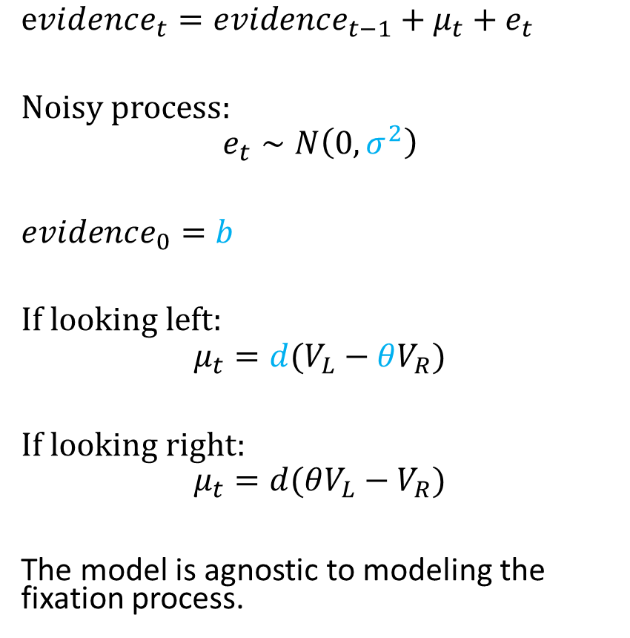
Attentional Drift-Diffusion-Model (aDDM)
$evidence_{t}=evidence_{t−1}+μ_{t}+e_{t}$
Noisy process:
$$e_{t}∼N\left(0, σ^{2}\right)$$
$evidence_{0}=b$
If looking left:
$$μ_{t}=d(V_{L}−θV_{R})$$
If looking right:
$$μ_{t}=d(θV_{L}−V_{R})$$
The model is agnostic to modeling the fixation process.
[Animate this]
Notes:
noisy
bias
drift: ddm in value based decisions: evidence accumulated is value comparison
drift
sim
explain fixation sampling process

Slide 6
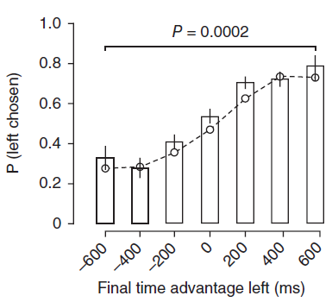
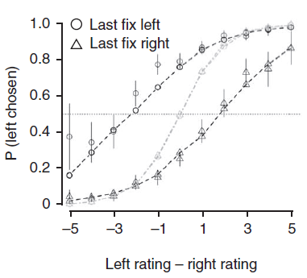
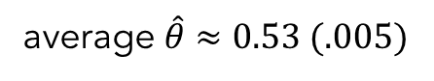
aDDM Predictions
average $\hat{θ}≈0.53 (.005)$
1. Attentional Discounting
2. Net Fixation Bias
3. Last Fixation Bias
Bhatnagar, Orquin (2022, J Exp Psychol Gen)
Krajbich, Armel, Rangel (2010, Nat Neuro)

Slide 7


[find a better picture]

Slide 8


Slide 10
Negative discounting

Slide 11
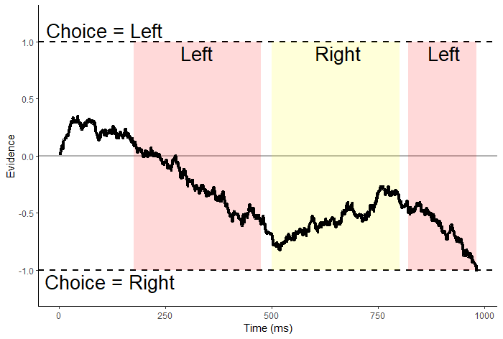
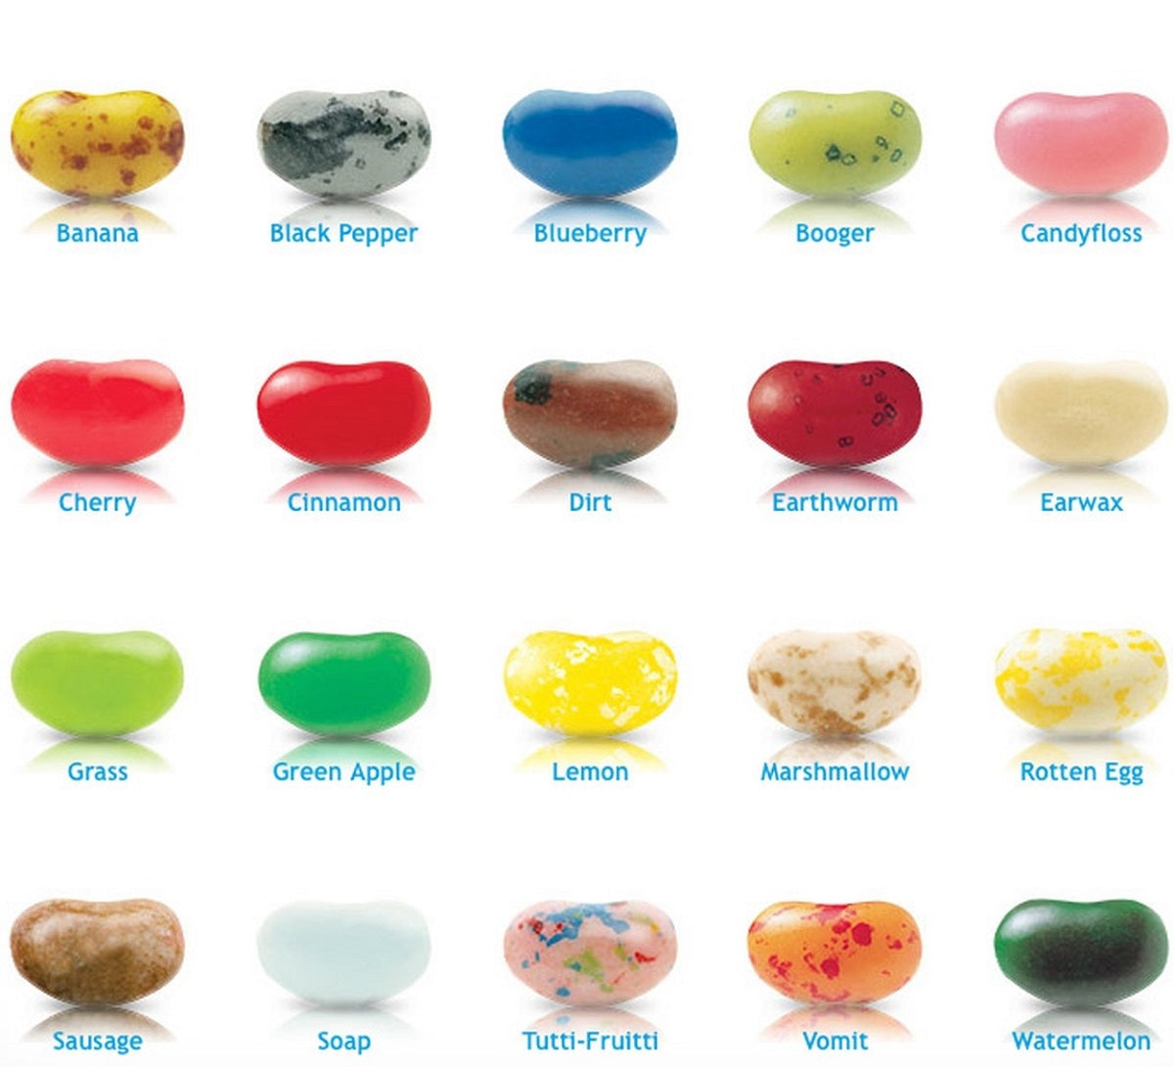
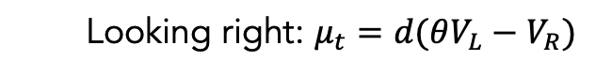
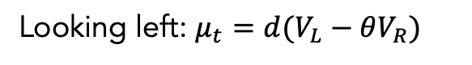
$evidence_{t}=evidence_{t−1}+μ_{t}+e_{t}$
Looking left: $μ_{t}=d(V_{L}−θV_{R})$
Looking right: $μ_{t}=d(θV_{L}−V_{R})$

Slide 12
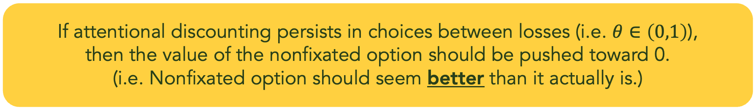
$evidence_{t}=evidence_{t−1}+μ_{t}+e_{t}$
Looking left: $μ_{t}=d(V_{L}−θV_{R})$
Looking right: $μ_{t}=d(θV_{L}−V_{R})$
If attentional discounting persists in choices between losses (i.e. $θ∈\left(0,1\right)$),
then the value of the nonfixated option should be pushed toward 0.
(i.e. Nonfixated option should seem better than it actually is.)

Slide 13
Attentional choice biases
Last Fixation Bias
Net Fixation Bias
Last fix. right
Last fix. left
P(Left Chosen)
P(Left Chosen)
Left Rating - Right Rating
Final Time Advantage Left (ms)

Slide 14
Attentional choice biases
should flip!
Last Fixation Bias
Net Fixation Bias
Last fix. right
Last fix. left
P(Left Chosen)
P(left chosen)
Left Rating - Right Rating
Final Time Advantage Left (ms)

Slide 15

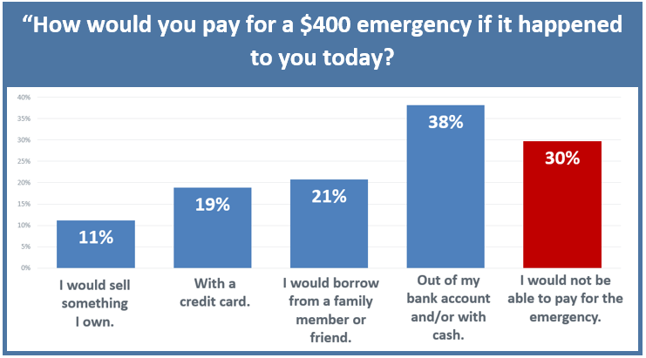
The Center for Community Solutions, Cleveland, Ohio

Slide 16
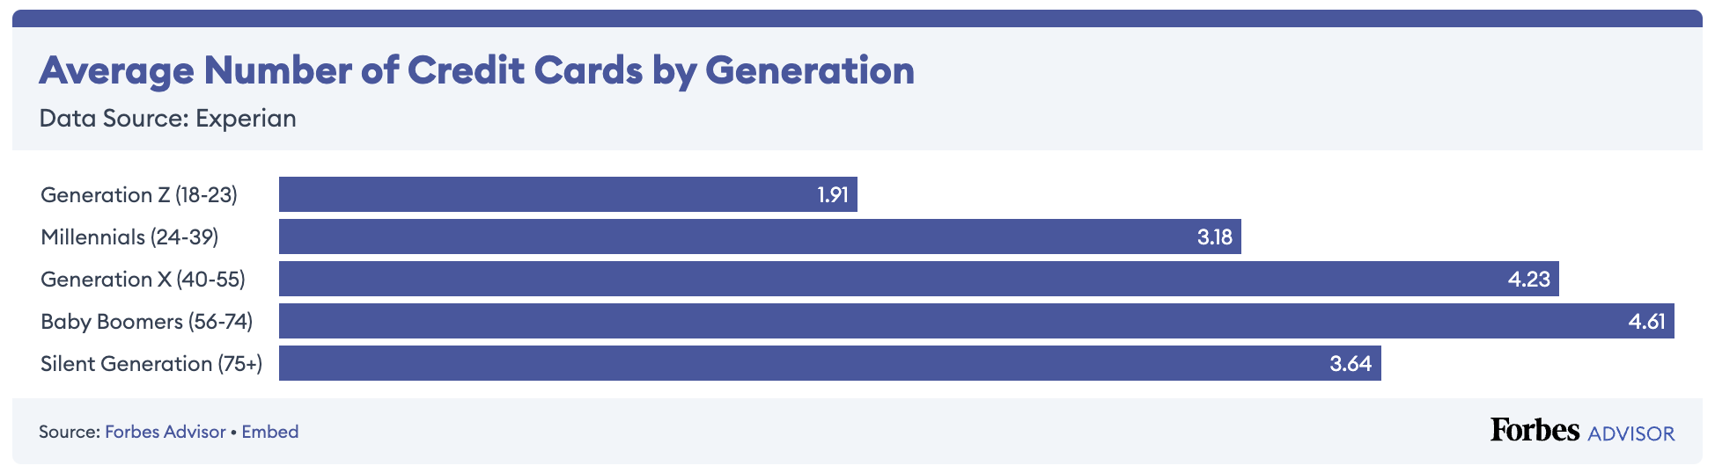
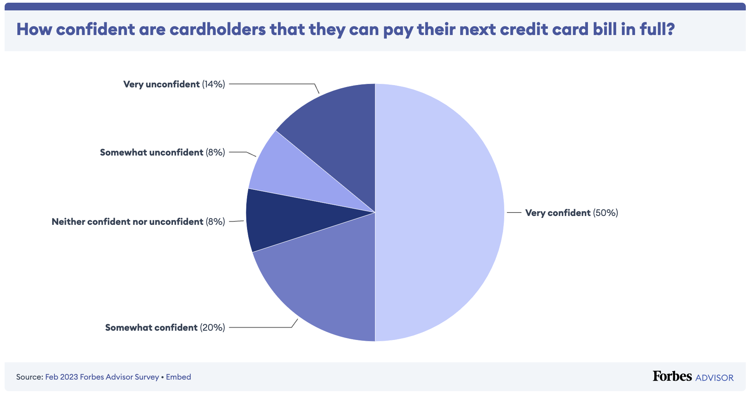

Slide 17
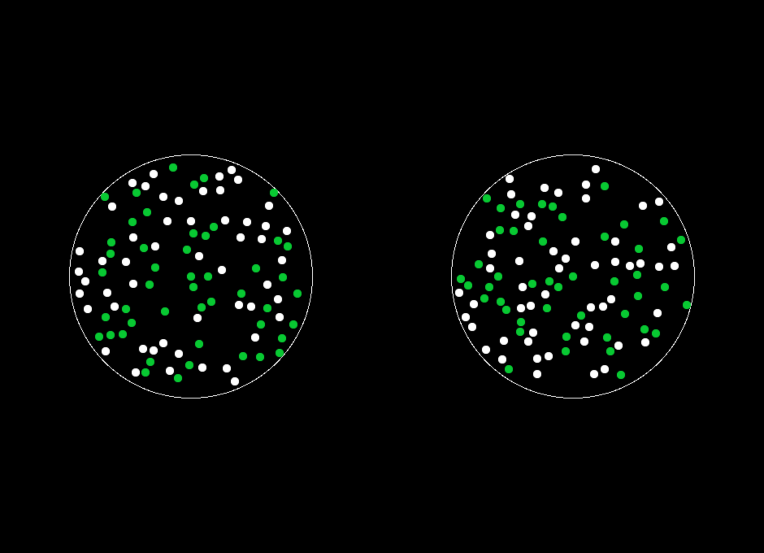
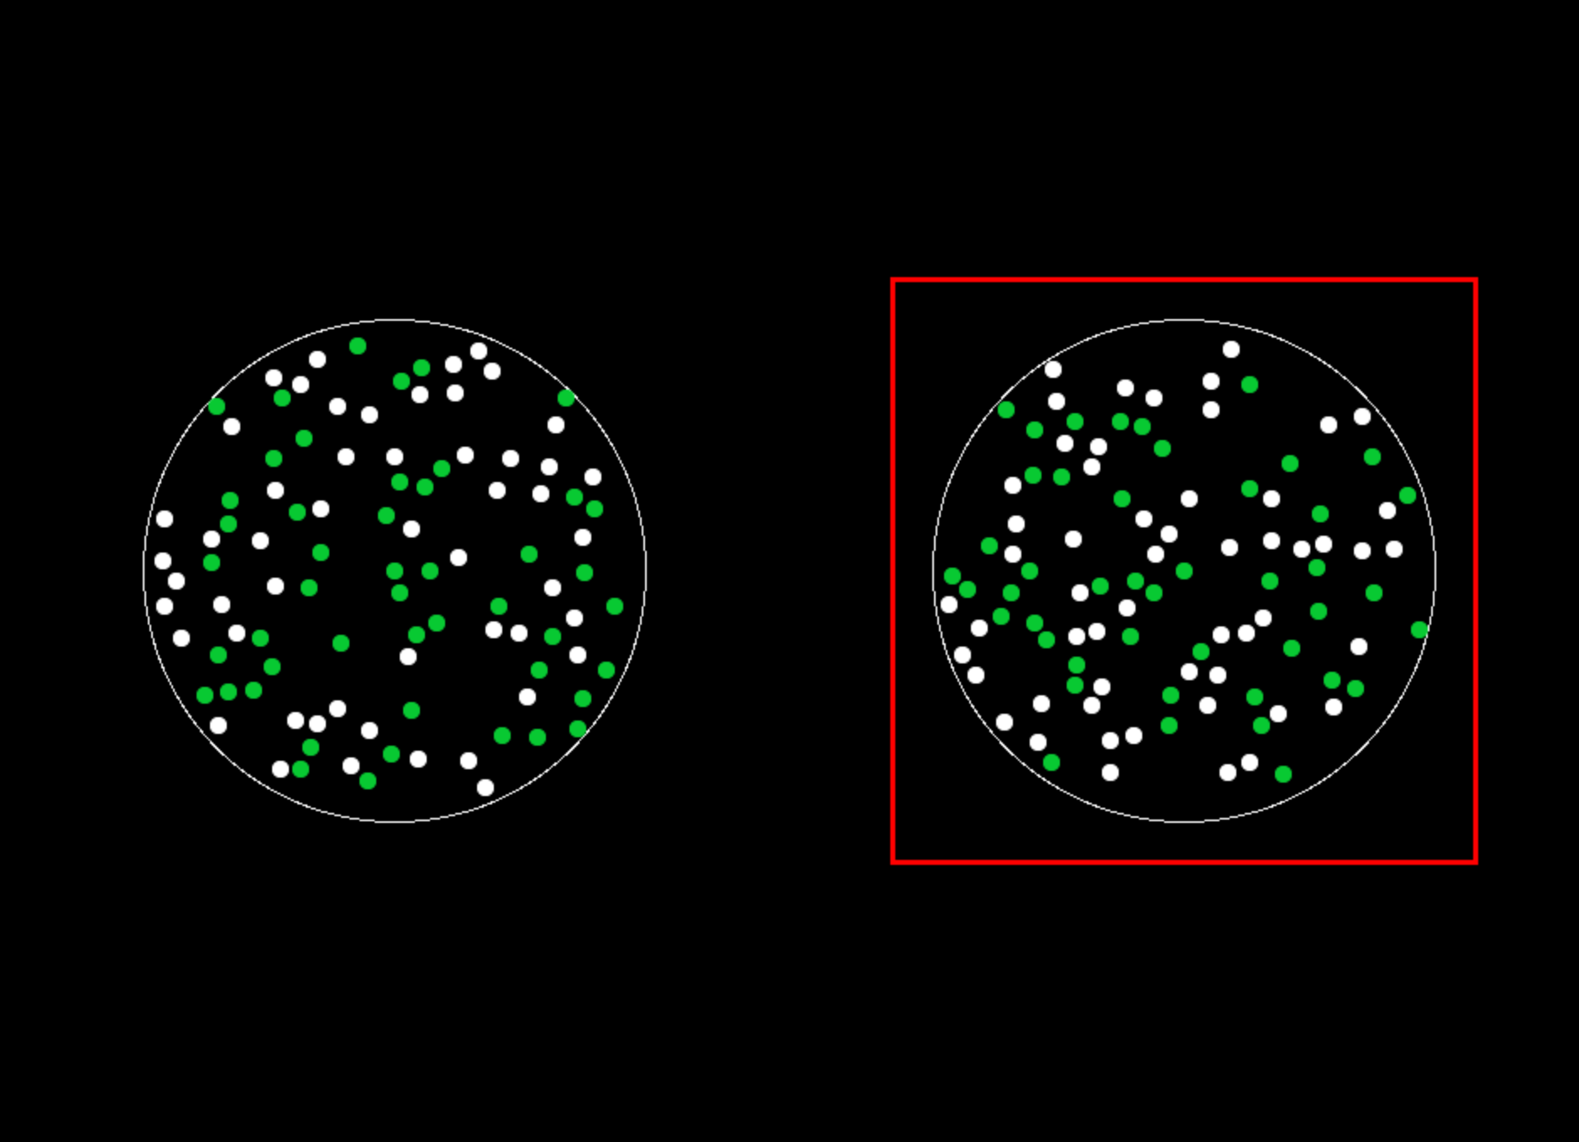

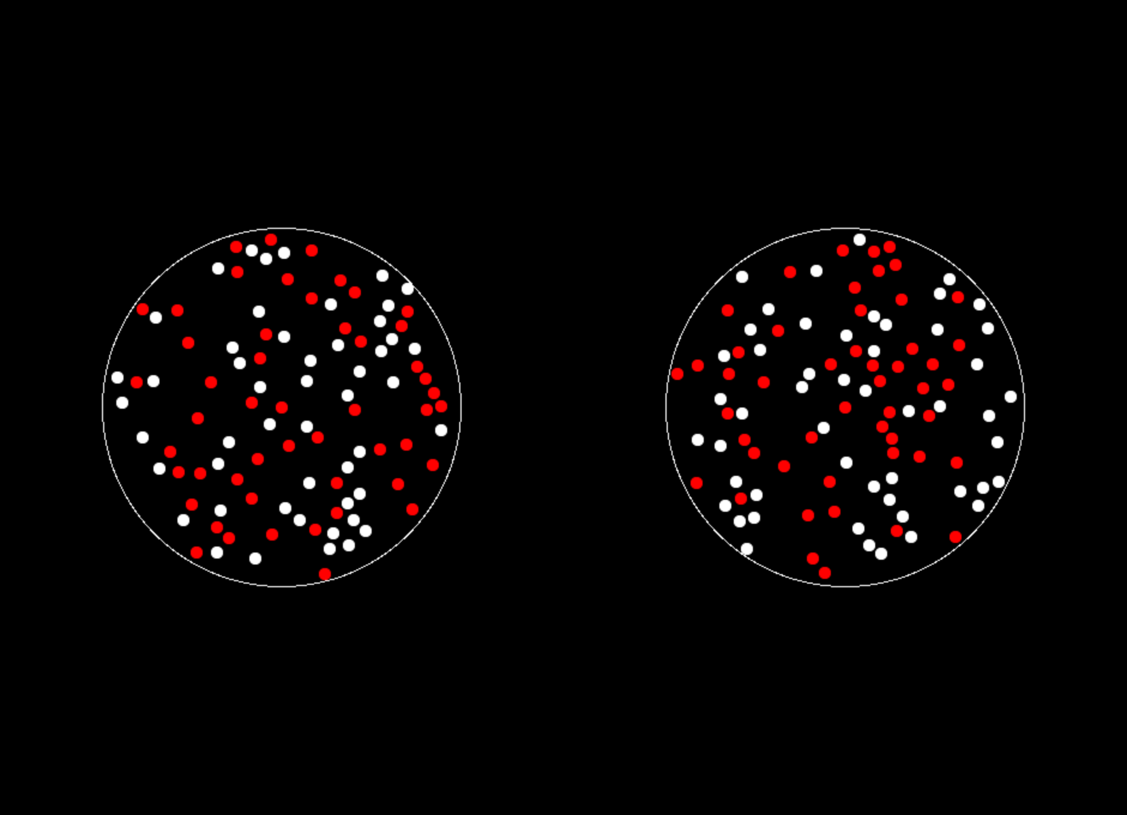
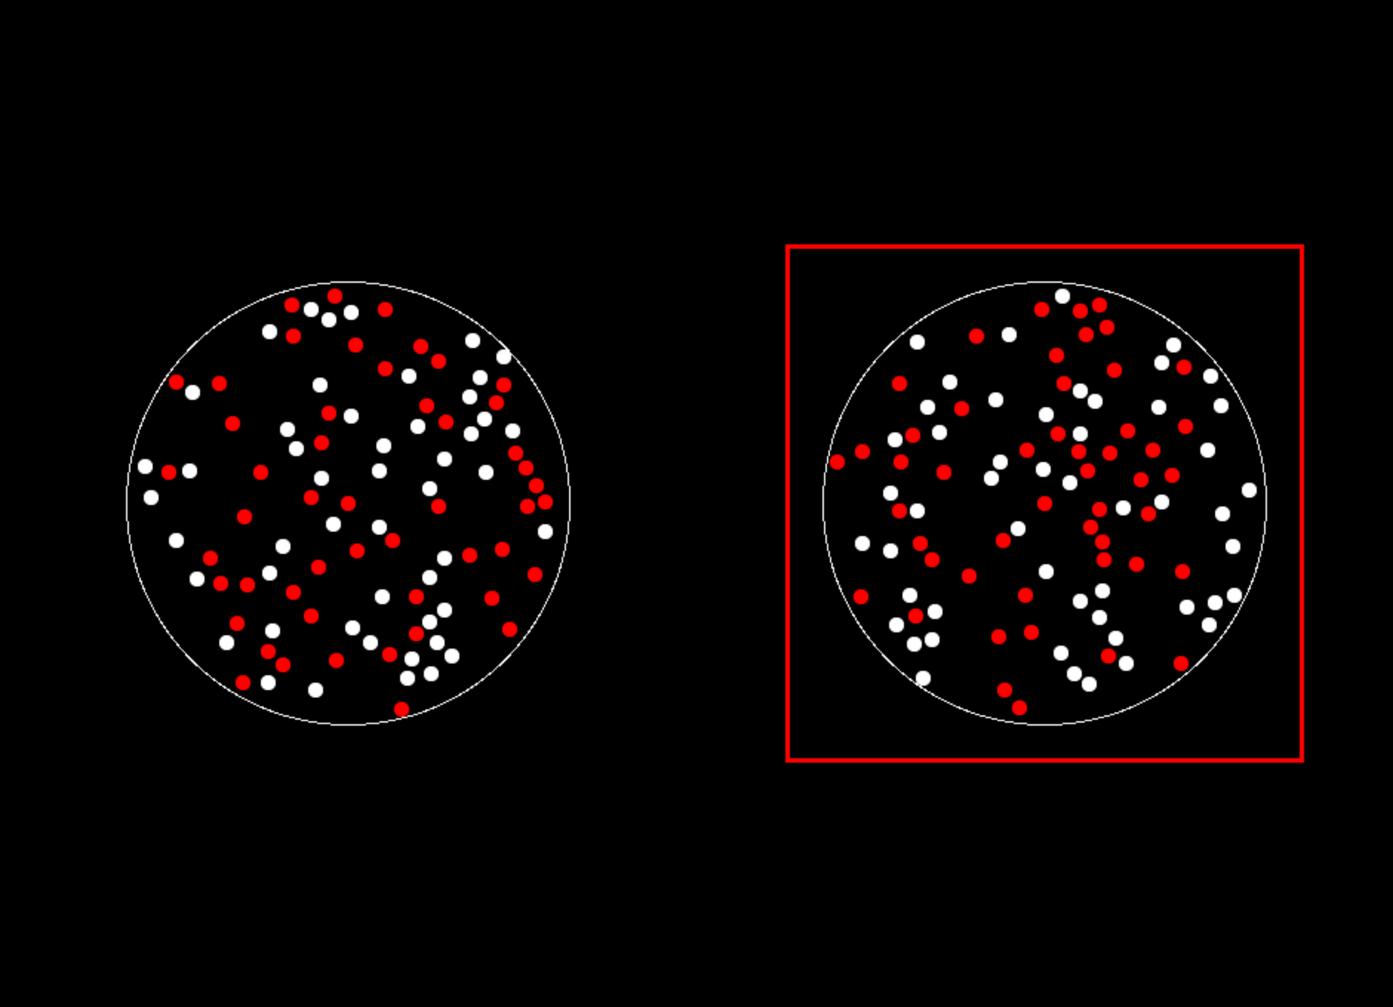
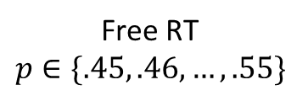
Study #1
N=35
400 trials
Gain
Loss
ITI
1 s
Free RT
$$p∈\{.45, .46, …, .55\}$$
Feedback
1 s
Eye-tracking

Slide 18
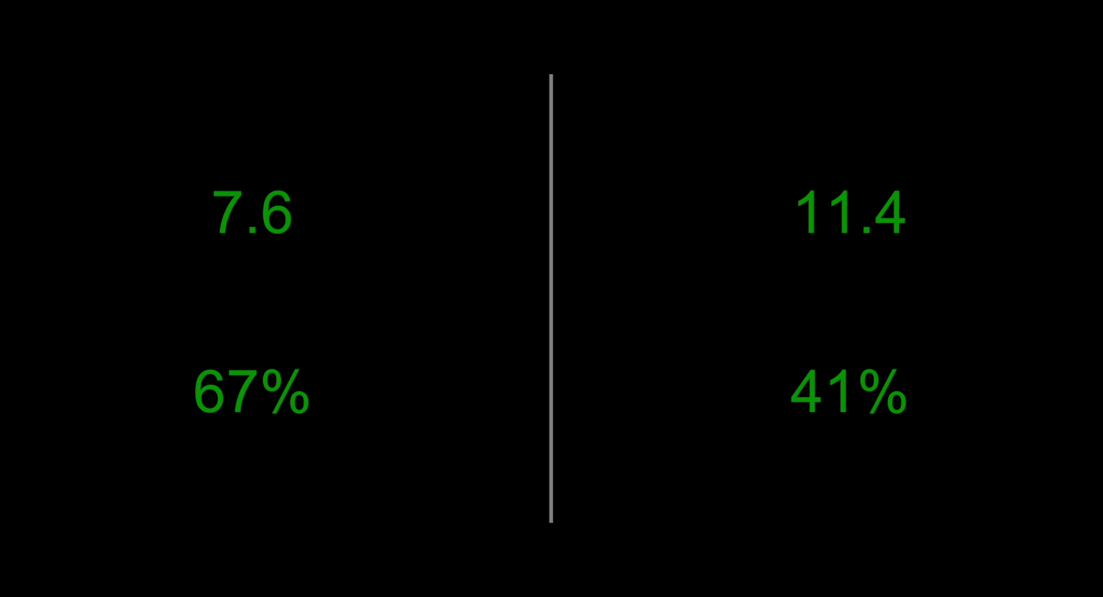
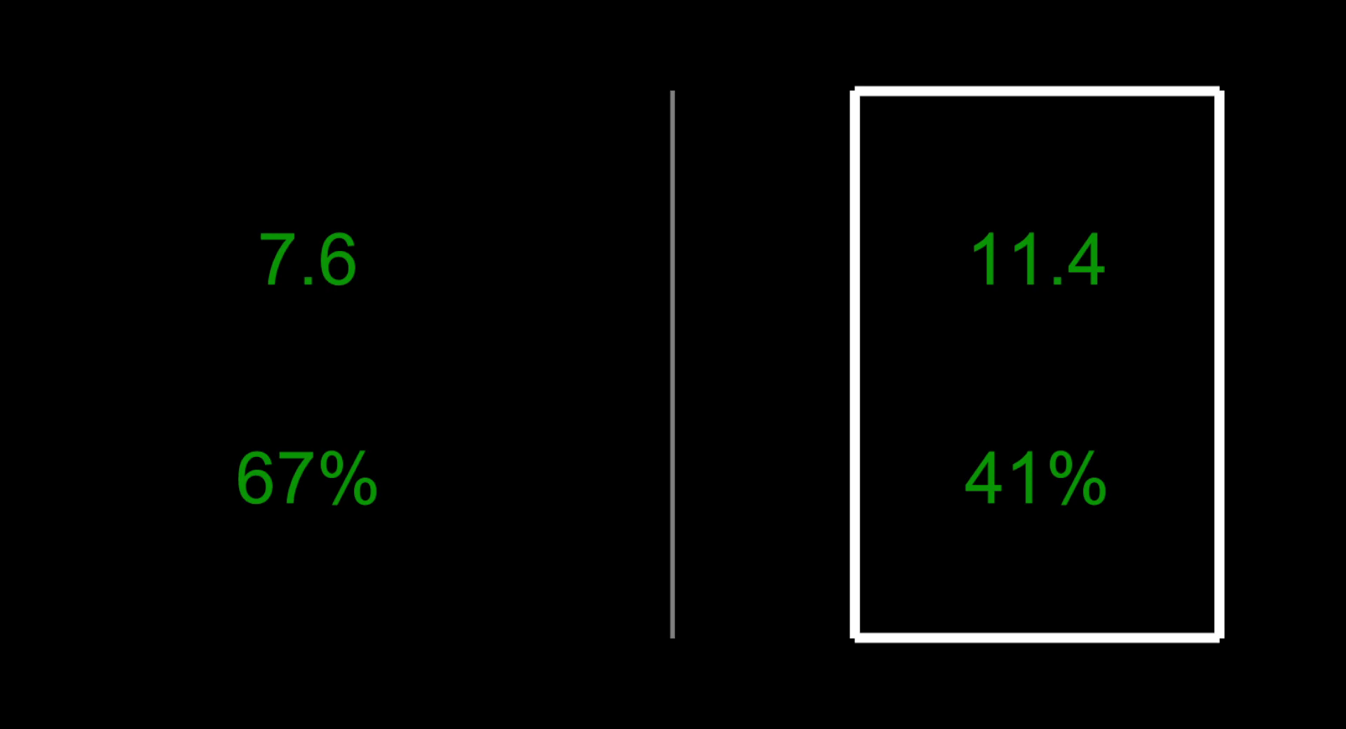
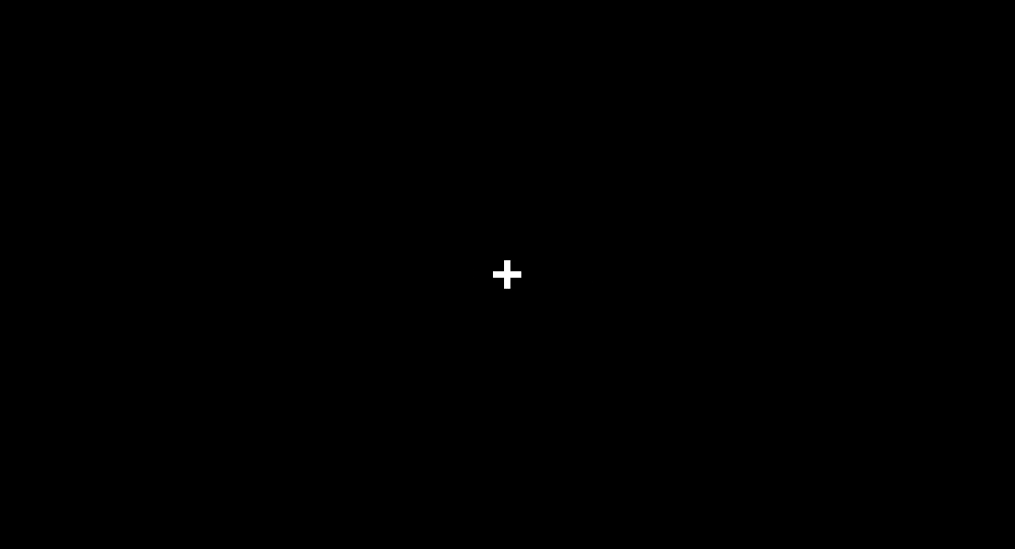
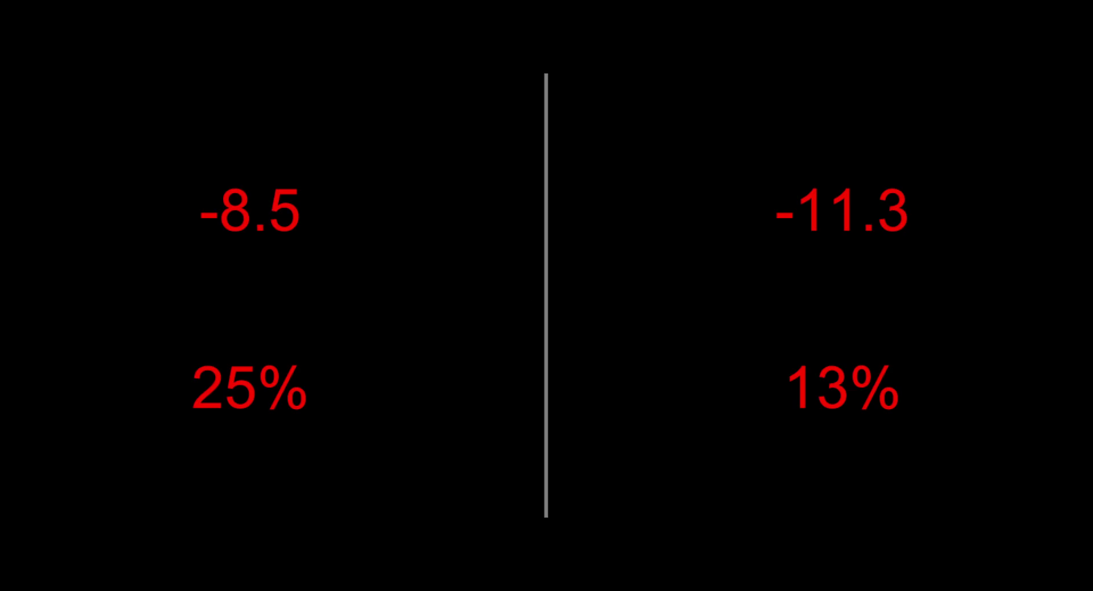
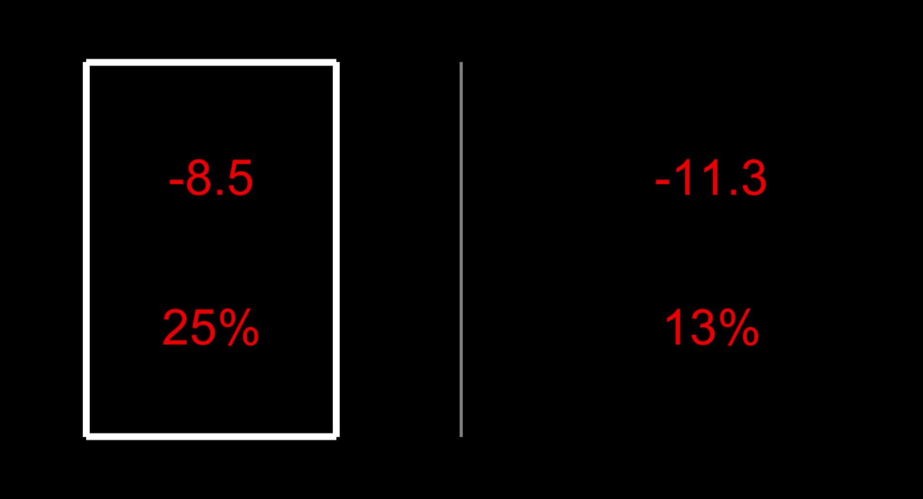
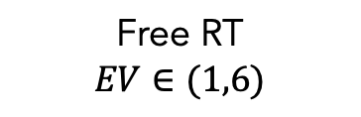
Study #2
N=26
340 trials
Gain
Loss
ITI
1 s
Free RT
$$EV∈(1,6)$$
Feedback
1 s
Eye-tracking

Slide 19
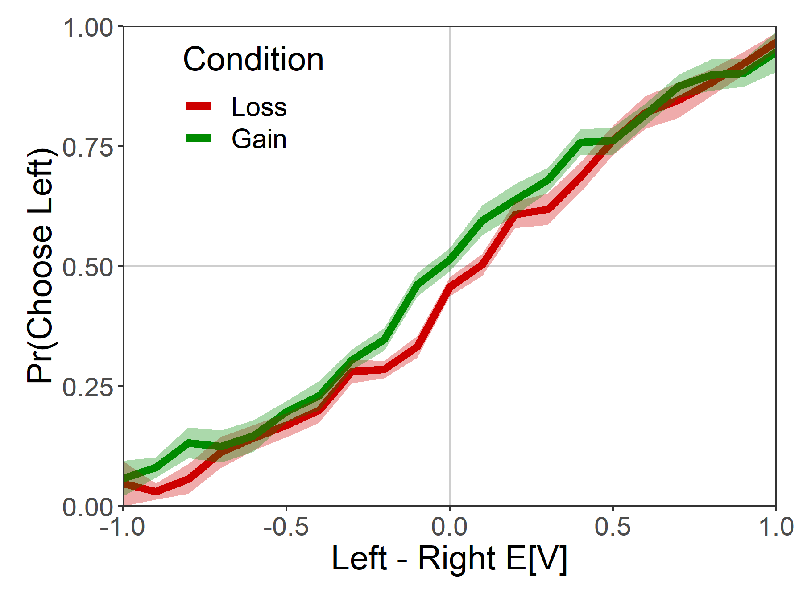
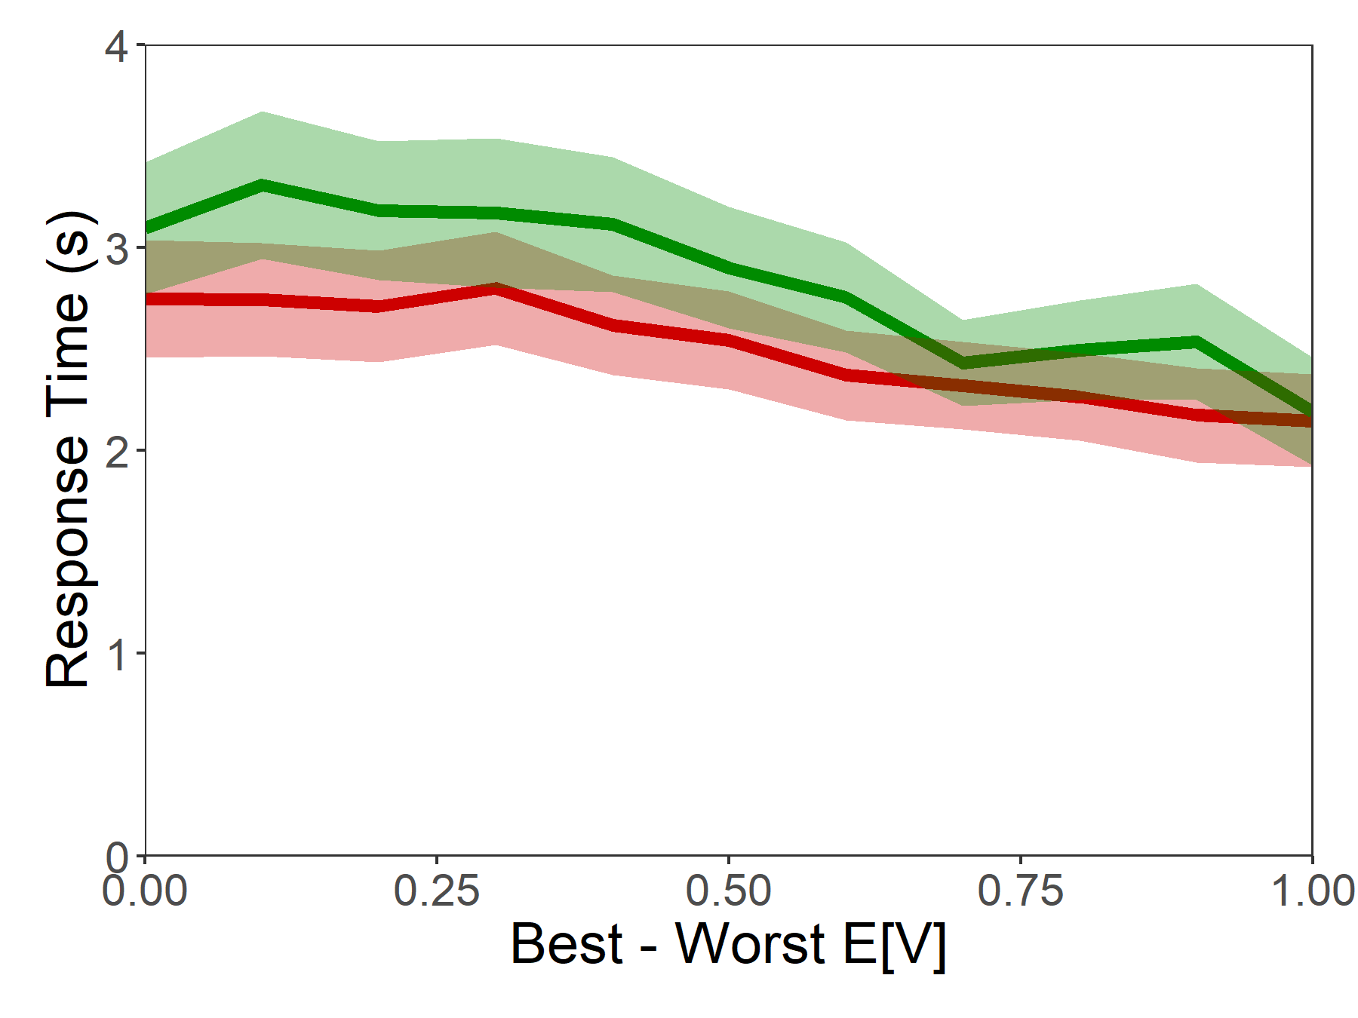
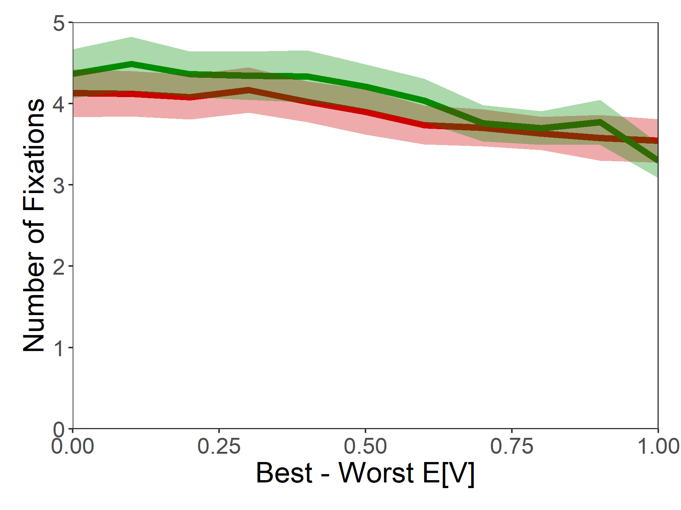
Psychometrics

Slide 20
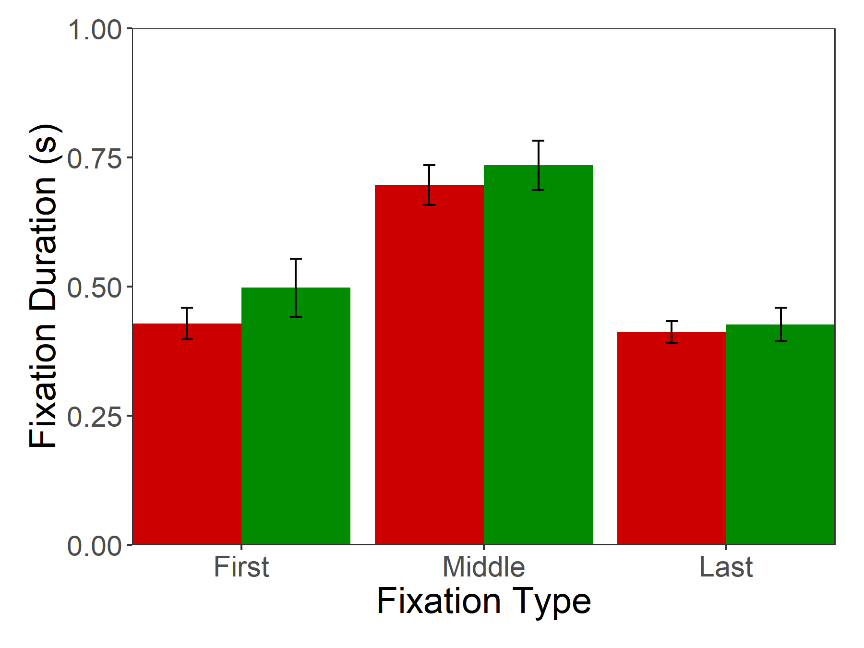
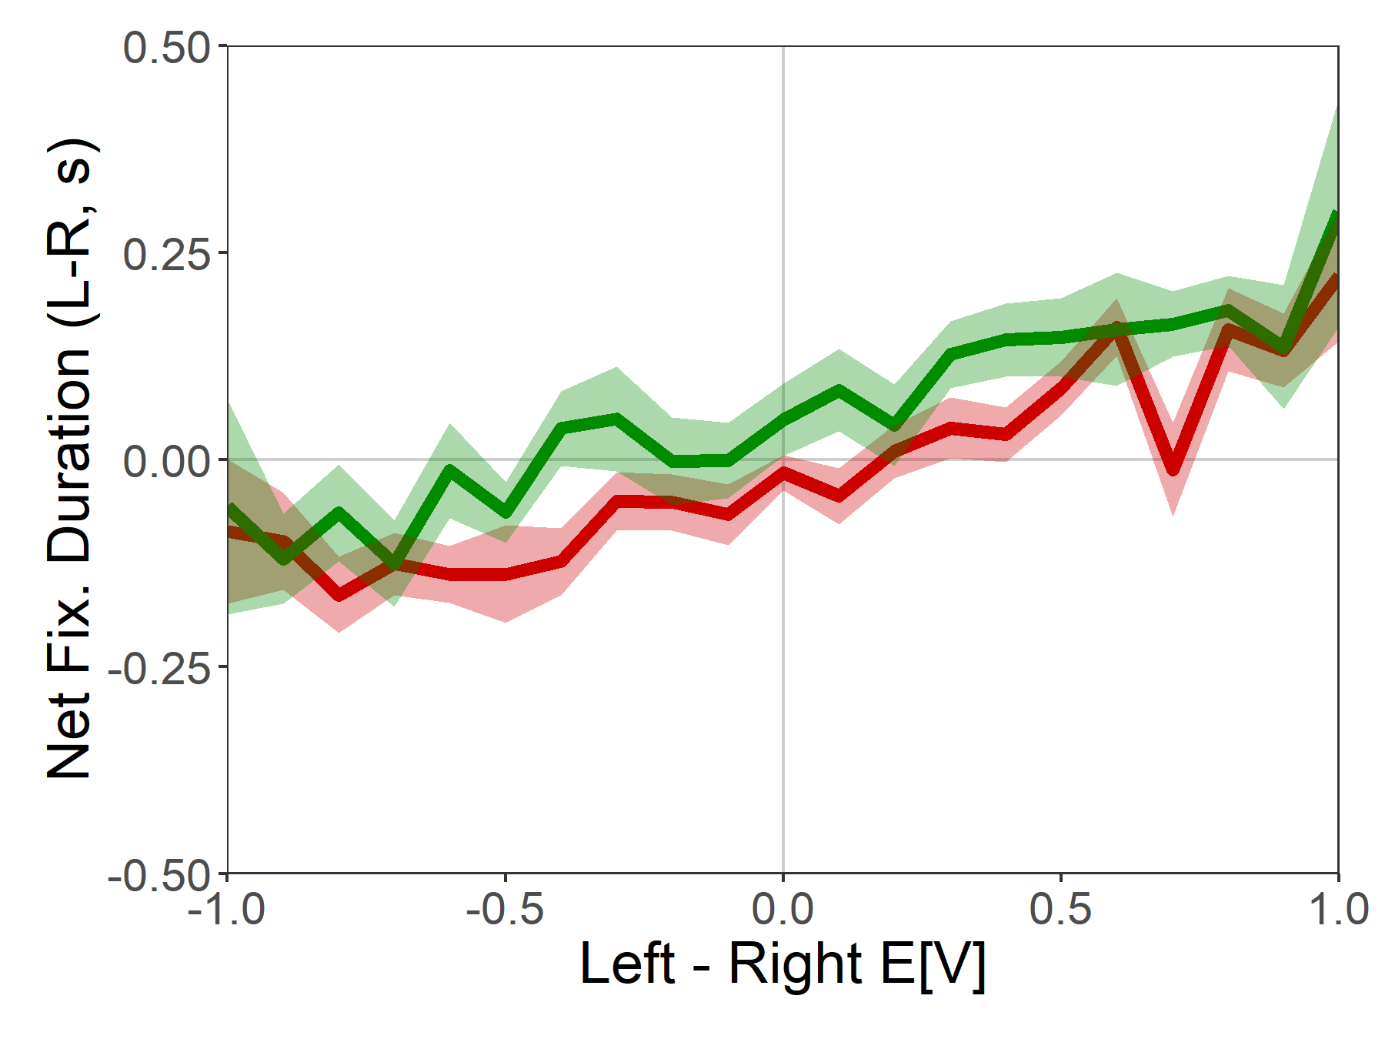
Fixation Properties

Slide 21
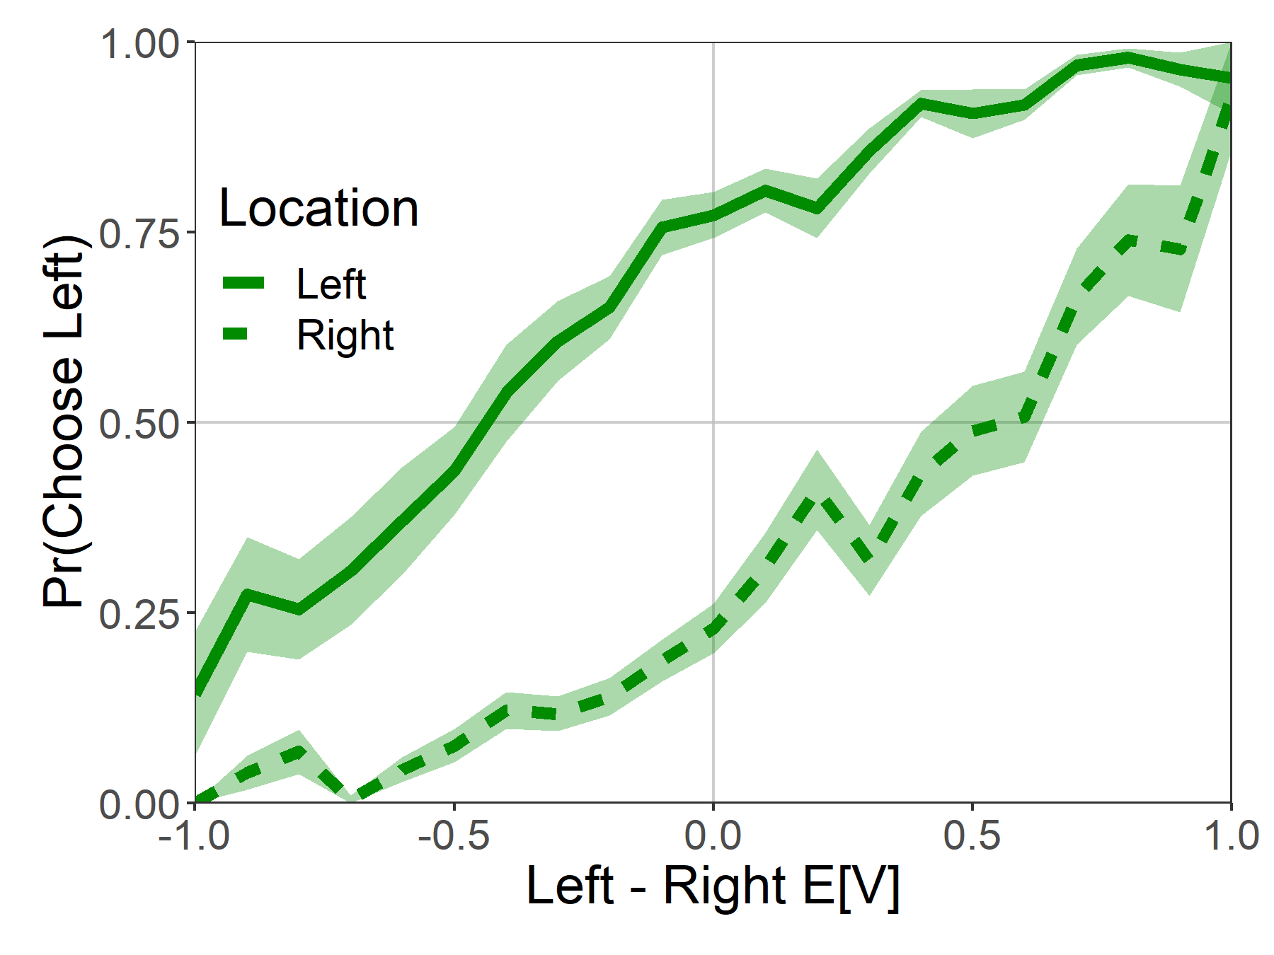
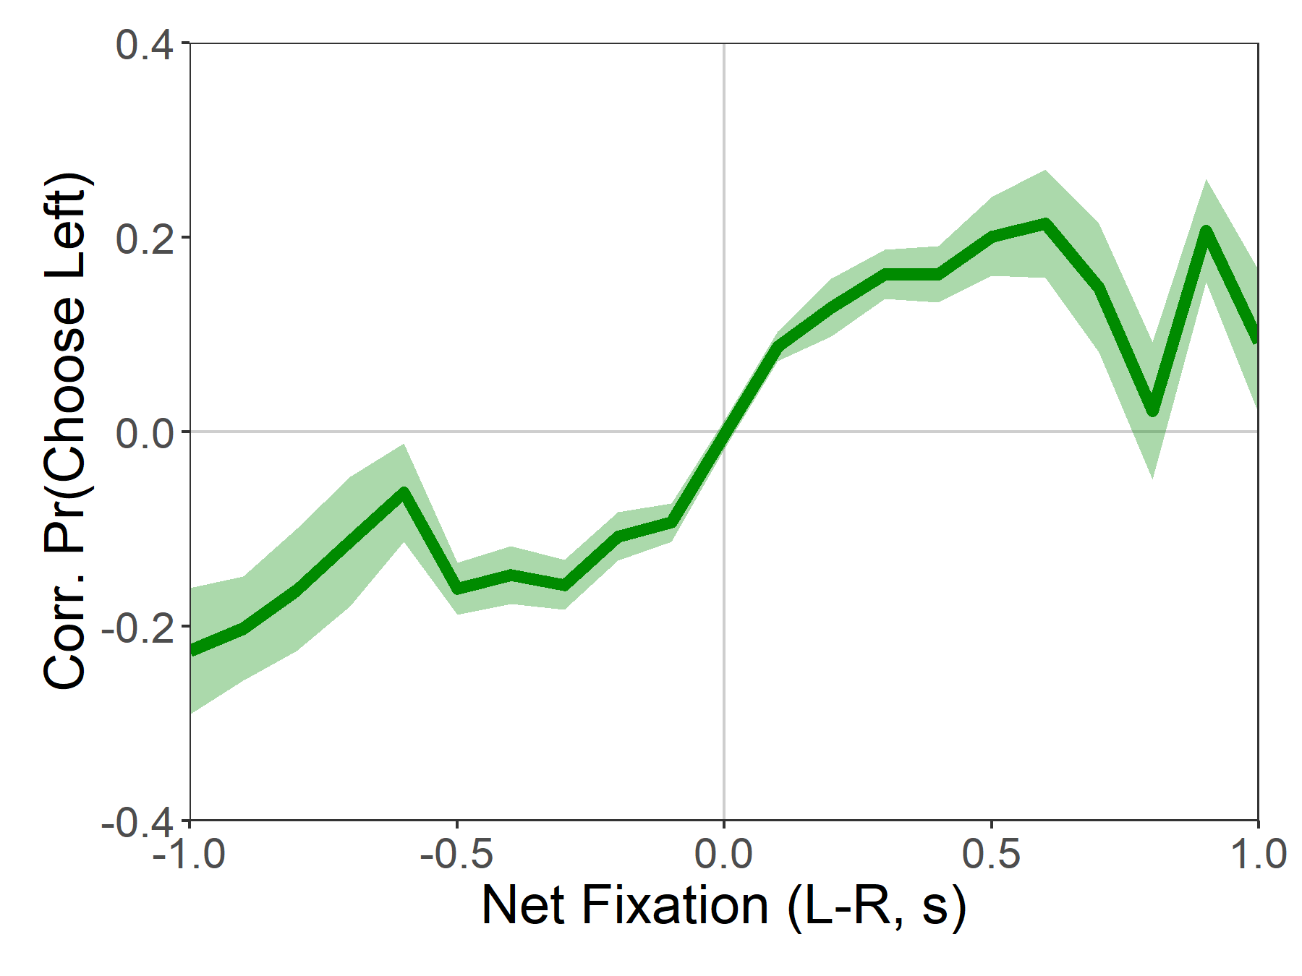
Attentional Choice Biases

Slide 22
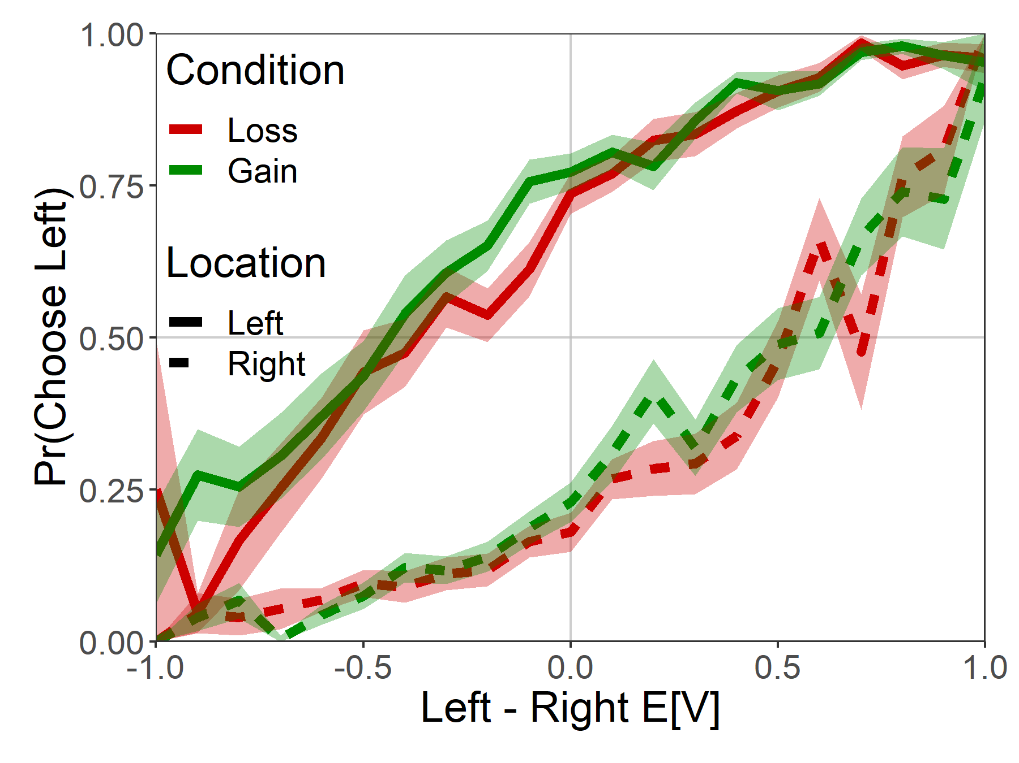
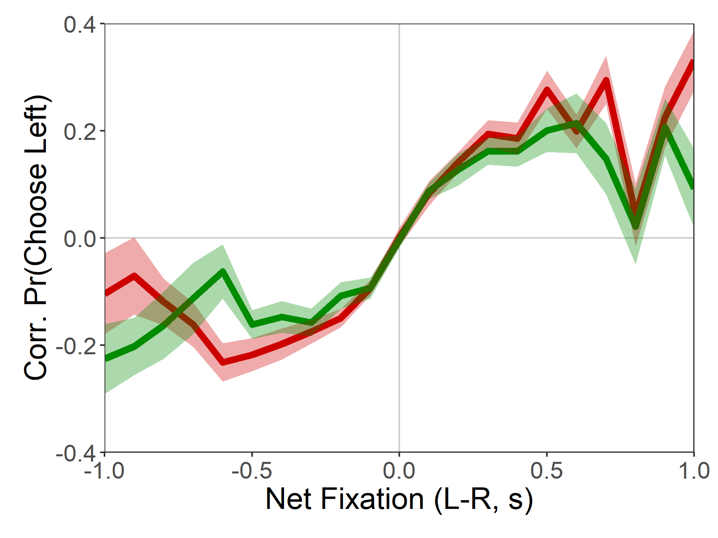
Attentional Choice Biases

Slide 23
Attentional Choice Biases

Slide 24
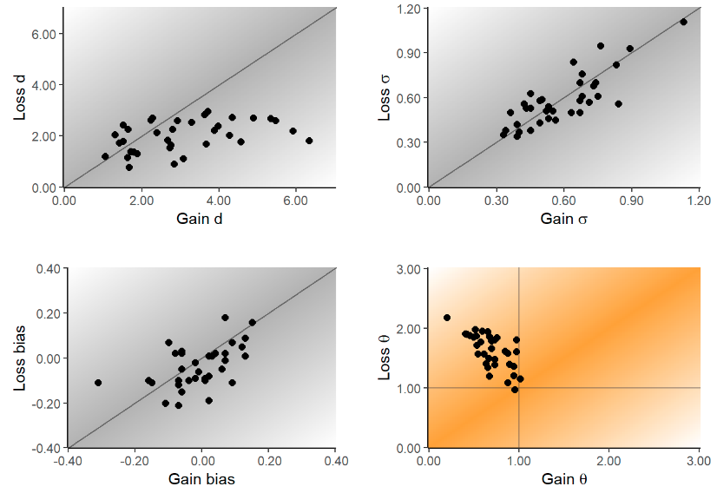
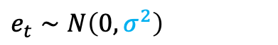
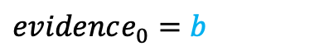


aDDM Parameter Estimates
[Need to include study 2 results]
$evidence_{t}=evidence_{t−1}+μ_{t}+e_{t}$
Looking left: $μ_{t}=d(V_{L}−θV_{R})$
Looking right: $μ_{t}=d(θV_{L}−V_{R})$
$$e_{t}∼N\left(0, σ^{2}\right)$$
$evidence_{0}=b$

Slide 25
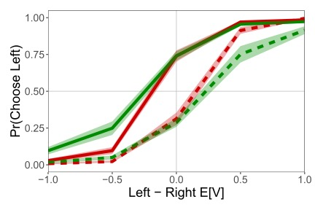
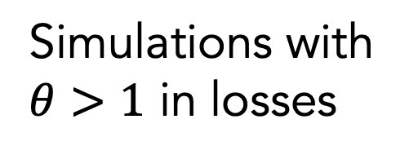
Observed Data
Simulations with
$θ>1$ in losses

Slide 26
Potentially add variation to aDDM slide here?
- if it fits
- if it fits better…

Slide 27
Conclusion
Contrary to one of the assumptions of the aDDM, we find evidence of attentional amplification of the nonfixated option in choices between losses.
Attention to an option still pushes choice towards that option, even in losses.
The aDDM is capable of capturing these effects if we relax the boundaries on its attention parameter.

